Slide 1
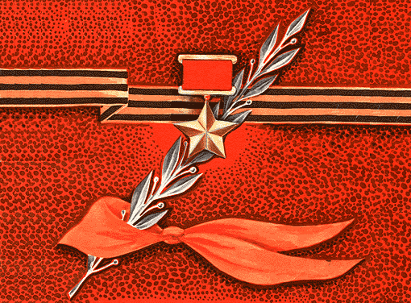

YOUNG PIONEERS, heroes of the great patriotic war
Let their memory
live for ever!

Slide 2
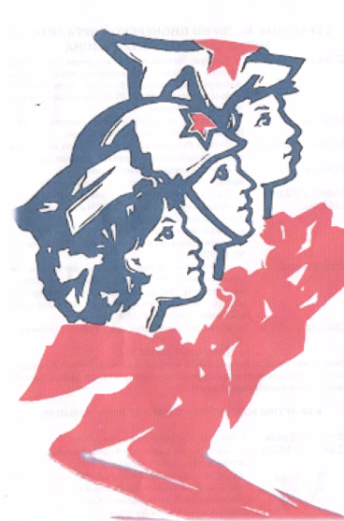
They were just common boys and girls and like all other children they dreamt of being happy. But their dreams could never come true…
The war has come and young pioneers stood up to defend their Motherland, to fight the fascists both at the front and in the rear. They gave their young lives for their Motherland, for freedom, for all of us.
Let their memory live for ever in our hearts!

Slide 3
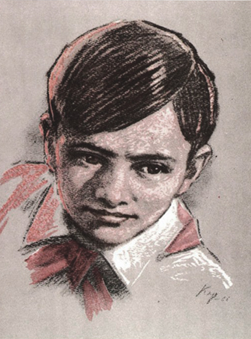
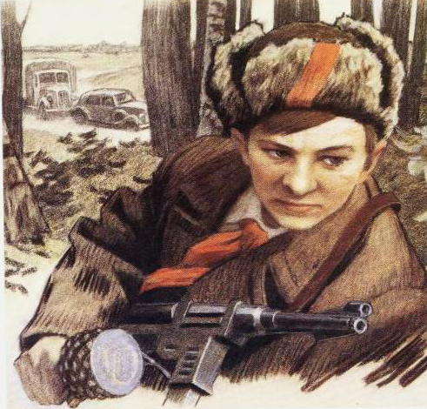
Valya Kotik
Born on February 11, 1930 in Kmelevka village, Shepetosky District, Khmelnitskaya Region. When the fascists occupied the village, Valya and his friends decided to fight the enemy. The boys picked up weapons left on the battle fields and delivered them to the partisans. The partisans entrusted Valya to be their messenger and scout. Once, when the fascists scheduled a punitive military operation against the partisans, Valya tracked out the German officer who commanded the punitive troops and killed him... When the fascists started arresting people, Valya, his mother
and his brother fled to the partisans. He fought the enemy shoulder to shoulder with the adults to free his home land. He derailed six German echelons heading to the front line.
Valya Kotik died as a hero and was awarded the title of the Hero of the Soviet Union. There is a monument to Valya Kotik in front of his school.

Slide 4
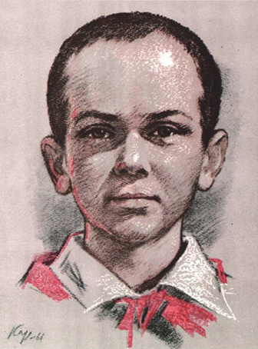
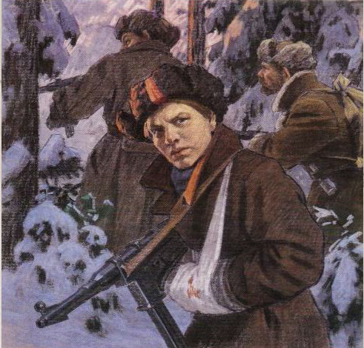
Marat Kazey
The war befell on the Belorussian land. The fascists occupied the village where Marat lived with his mother. In autumn Marat could not go to school. The fascists turned the school building into their quarters. The enemy was very cruel. Marat’s mother was arrested for her contacts with partisans. And soon Marat found out that his mother was hanged in Minsk. His heart filled with hatred for the enemy. He escaped to the partisans with his sister. Soon he became a scout in the partisans’ headquarters and used to obtain valuable information. Based on this information the partisans destroyed the
fascist garrison in Dzerzhinsk city. Marat was always brave and fearless in fighting the enemy.
Marat died in a battle. He fought until only one grenade was left. Then he allowed the fascists to come near him and blew them up… and himself too… For his courage and valour young pioneer Marat Kazey was awarded the title of the Hero of the Soviet Union. There is a monument to this young hero in Minsk.

Slide 5
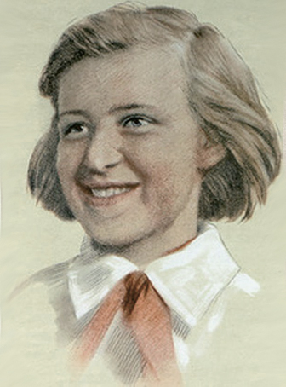
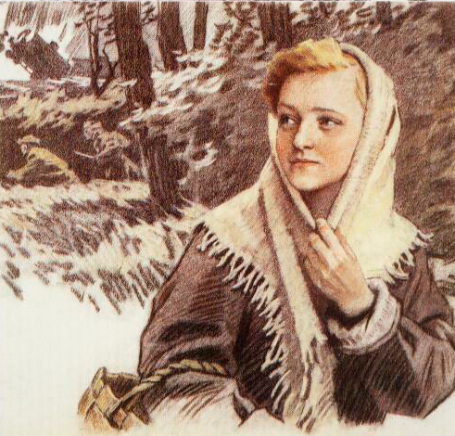
Galya Komleva
In Tarnovich village of Leningrad Region the leader of the young pioneers’ organization Anna Semenova chose the most reliable pioneers for contacting the partisans, and Galya Komleva was the first among them. The young messenger used to bring partisans’ instructions to Anna and deliver her reports back to the partisans along with bread, potatoes and other food which was very hard to procure. Once, when a messenger from the partisans failed to arrive on time, Galya, half-frozen, made her way through the forest, delivered the message and, after she had warmed
up a little, hurried back to the village with a new instruction. She and her friend, young komsomol member Tasya Yakovlleva, distributed leaflets in the village at night. The fascists tracked out and arrested them. For two months they were held in prison. The fascists beat her badly, threw to the prison cell and next morning interrogated again. Nothing did she say to the enemy, no one did she betray. The young patriot was shot dead by the fascists.

Slide 6
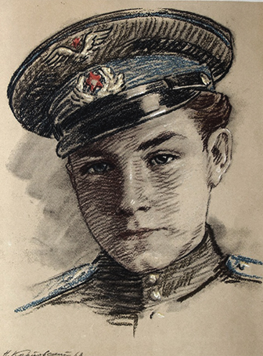
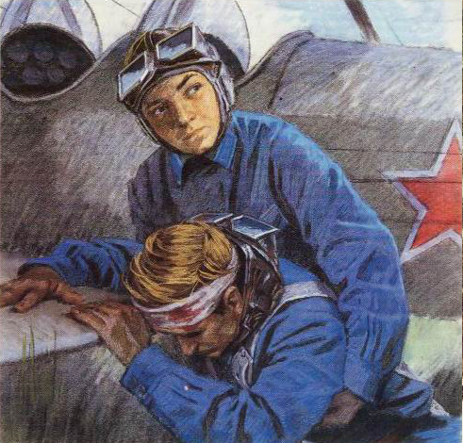
Arkady Kamanin
He dreamt of the sky when he was just a little boy. Arkady’s father, Nikolay Petrovich Kamanin, was a pilot and rescued polar explorers from the wrecked Cheluskin ship. For this feat his father was awarded the title of the Hero of the Soviet Union. His father’s friend, great pilot Mikhail Vasilievich Vodopianov also served a good example for the young boy. But Arkady was not allowed to fly on his own. ‘First you should grow up’, he was always said. When the war began he began working at an aviation plant, then at the airfield. He used any chance to rise to the sky. Once the pilot was
wounded and Arkady landed the plane himself. After that Arkady was allowed to learn flying. Soon he started piloting planes on his own. Once he saw from the sky a wrecked Soviet plane. Under severe mortar fire he landed his plane, transported the wounded pilot to his plane, rose to the sky and returned to his airfield. The Red Star Decoration shone on his chest.

Slide 7
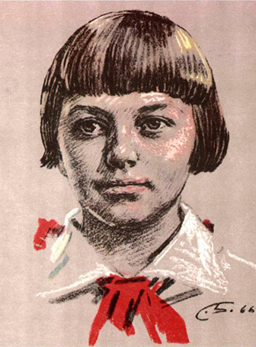
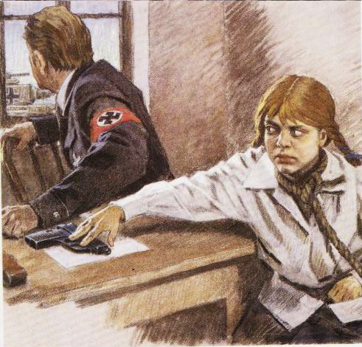
Zina Portnova
The war found young Leningrad pioneer Zina Portnova in Zuya village of Vitebsk Region where she was spending her vacation. An underground komsomol and youth organization Young Avengers was established in Obol, and Zina was elected its member. She participated in subversive activities, distributed leaflets, scouted for the partisans.
In December 1943 she was returning from a mission. In Mostischi village she was given away by a traitor. The fascists seized the young partisan and tortured her. But only silence, contempt and hatred were her answer
to the enemy. At interrogation Zina grabbed a pistol from the table and shot the fascist. Another officer who heard the shooting ran into the room just to be shot dead as well.
Zina tried to run away but the fascists caught her… She was tortured to death but she resisted to her last breath. Zina was awarded the title of the Hero of the Soviet Union.

Slide 8
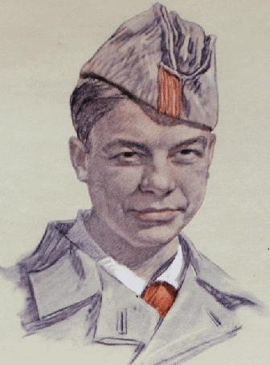
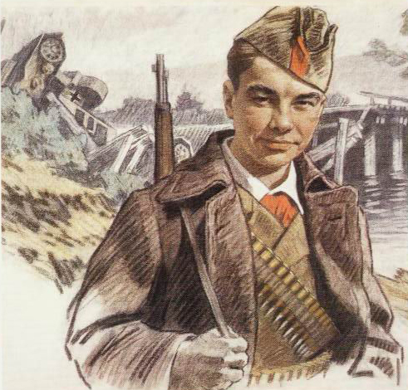
Vasya Korobko
Chernigov Region. A platoon of Soviet troops was fighting the enemy to cover the retreat of the main forces. A young boy was delivering cartridges to soldiers. The boy’s name was Vasys Korobko.
At night he carried out the red young pioneers’ flag from the school building occupied by fascists. Outskirts of the village. Vasya sits under the bridge taking out the iron cramps and sawing the piles. In the morning from a shelter he watches the bridge crashing under the German armoured vehicles. The partisans entrusted Vasya to become a scout in the den of the enemy.
He heats the stoves and listens what fascists say, remembers and delivers information to the partisans. The fascists forced Vasya to lead them to the forest to find the partisans. But Vasya led them to the ambush of the Polizeis. In the dark the fascists took them for partisans and opened wild fire, killed all the Polizeis and suffered bad casualties themselves. Together with the partisans Vasya destroyed nine echelons and killed hundreds of fascists. In one of severe battles he was shot down.

Slide 9
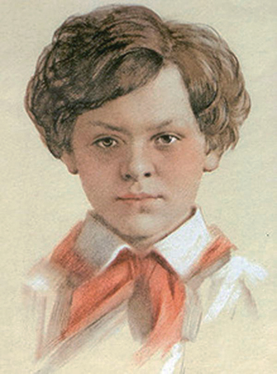
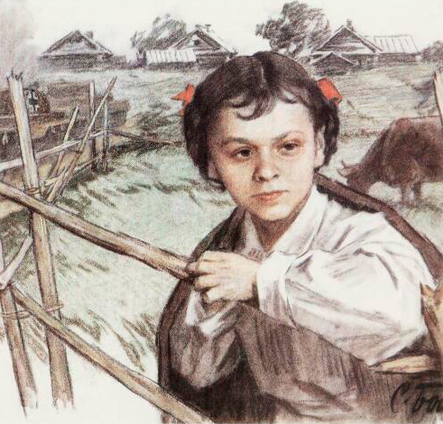
Lara Mikheyenko
Leningrad schoolgirl Larisa Mikheyenko was recommended to receive the Government decoration for exploding the railway bridge over the Drissa river. But the award was never presented to her… The war cut off the girl from her native town. In summer she left for vacations to Pustoshkinsky district and could not return as the village was occupied by fascists. The young pioneer dreamt of making her way to the Soviet troops and one night she left the village with two elder girls. At first the partisan commander refused to admit them saying they are too small to be partisans. But the girls
managed to do what the adults could not. Dressed in rags Lara wondered around villages finding out where and how the gunnery is located and where the guards are posted. She also took part in combat operations. She was betrayed by a traitor, caught and shot to death by fascists. There is a bitter word in the Decree on awarding Larisa the Decoration of Patriotic War of the 1st grade. And this word is “postmortem”.

Slide 10
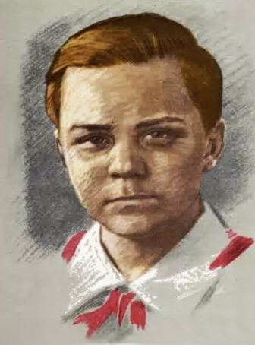
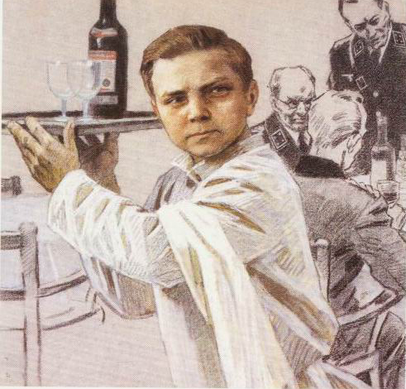
Vitya Khomenko
Vitya was very good in German at school, and the partisans instructed him to work in the German officers’ canteen. He washed dishes, serviced the officers and listened what they were saying. Drunken fascists often gave away secret information. Soon German officers noted that Vitya was clever and bright. They made him their messenger at the headquarters. It could never occur to them that the most secret information was delivered directly to the partisans. Once Vitya was instructed to cross the front line with his friend Shura Kober and establish communication with Moscow.
They reached Moscow, reported the information and came back to Nickolaev city with a radio station, explosives and weapons. On December 5, 1942 fascists caught and executed ten partisans including two young boys Shura Khober and Vitya Khomenko. Nowadays Vitya’s school bears his name.

Slide 11
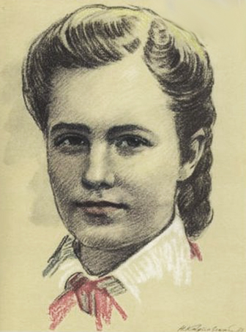
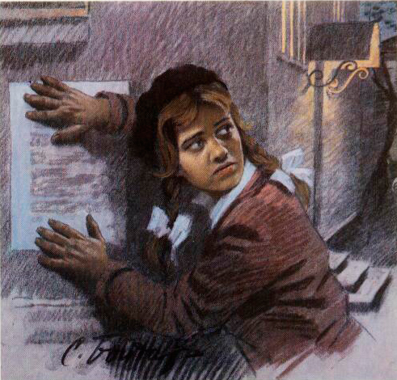
Lida Vashkevich
There were underground resistance groups in Grodno city occupied by fascists. One of the groups was led by Lida’s father. Partisan and underground messengers used to visit him and the commander’s daughter was always on the watch near the house. She looked out into the night and listened if the Polizei or German patrols were coming to give sign to her father if necessary. Lida used to obtaine paper for leaflets buying by a couple of sheets here and there with the help of her friends. She used to deliver leaflets to the specified place and distribute them late at night, and in
the morning all the city read on victories of the Soviet Army near Moscow and in Stalingrad.
She visited safe houses and warned the resistance activists on fascists raids. Lida hid explosives in her black bag filled with coal and safely passed by fascist guards. This bag is displayed in the Grodno City Museum along with her pioneer tie which she always carried hidden in her bosom as she could not even think of parting with it.

Slide 12
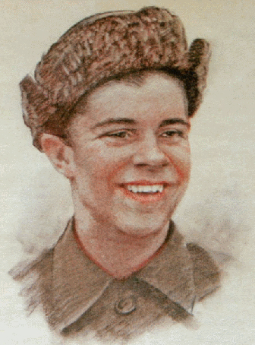
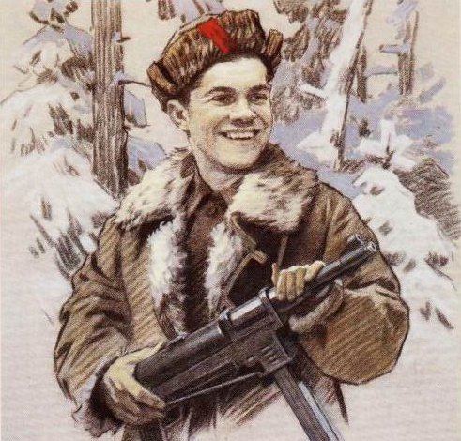
Sasha Borodulin
The war was going on. Enemy bombers were roaring over Sasha’s village. Sasha decided to fight the fascists. First he got a rifle. Then he killed the enemy motorcyclist and took his first trophy of war – the real German submachine gun. Day after day he scouted and performed the most dangerous tasks. Sasha destroyed a lot of enemy vehicles and killed many fascists. In winter 1941 Sasha Borodulin was awarded the decoration of the Red Flag for his courage and bravery. Once the fascists tracked out the partisans. For three days and nights the partisan squad tried to escape,
twice they managed to break through the enemy encirclement just to be encircled again. Then their commander called for volunteers to cover the retreat of the main troops. Sasha was the first to step out. There were five of them. One after another they died, and Sasha was the only one left. He could retreat himself, but every minute was precious for his retreating friends, and Sasha fought until the end. He allowed the fascists to come near him, took out the grenade and blew them all up, and himself too…

Slide 13
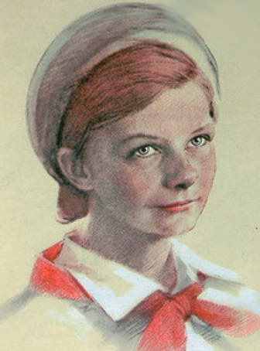
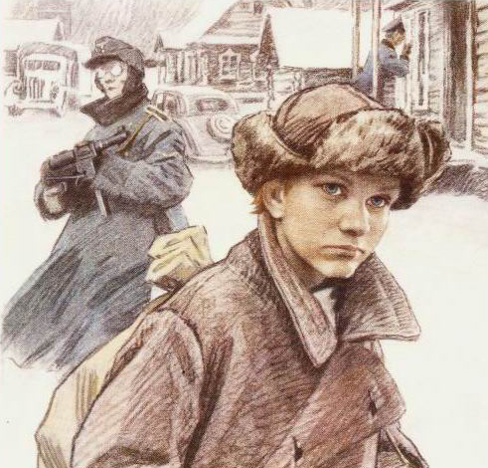
Yuta Bondarovskaya
The war found Yuta in a village near Pskov. She started helping the partisans. First Yuta was a messenger, then a scout. Dressed as a beggar she gathered precious information: where fascist headquarters are located, how they are guarded, how many machine guns they have. Every time when she was back home she put on her red tie. After Leningrad Region was liberated the girl stayed with the partisans to keep fighting the enemy on Estonian land.
It happened on February 28, 1944. The partisans stayed for rest on a khutor not occupied by fascists. The enemy
attacked the khutor and the partisans rushed forward to battle. But when they killed almost all the fascists and headed for the forest, there was no Yuta among them. She was found later. Yuta Bondarovskaya, a young pioneer who did not part with her red tie, died as a hero. The partisans buried her by a small river running by Rostov khutor not far from the Chudskoe lake.

Slide 14
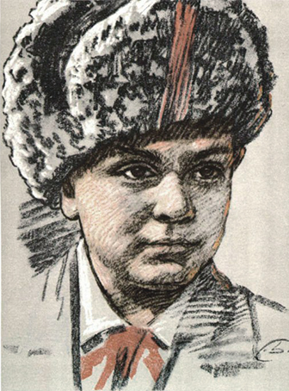
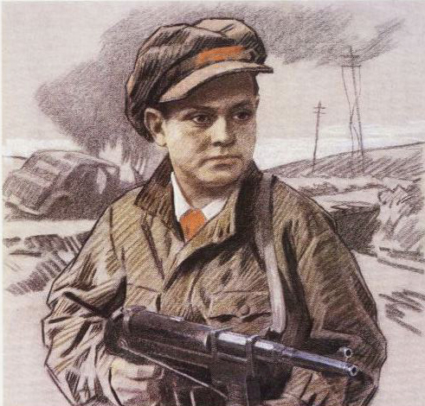
Lenya Golikov
Lenya was grown up in Lukino village on the Polo river that flows in the legendary Ilmen lake. When his village was occupied by the enemy the boy joined the partisans.
He often scouted and delivered important information to the partisans. And derailed were the enemy trains, destroyed were the bridges, burnt enemy warehouses…
There was one battle in his life that he fought face to face with a fascist general. The boy threw a grenade hitting a car. An officer got out of the car with a case in his hand trying to escape and shooting at the boy.
Lenya ran after him. He was chasing the fascist for almost a kilometer and shot him at last. There were very important documents in the officer’s case, and the partisans immediately sent them to Moscow by plane.
Lenya perished in a severe battle at Ostraya Luka village in winter 1943. Pioneer and partisan Lenya Golikov was awarded the title of the Hero of the Soviet Union postmortem.

Slide 15
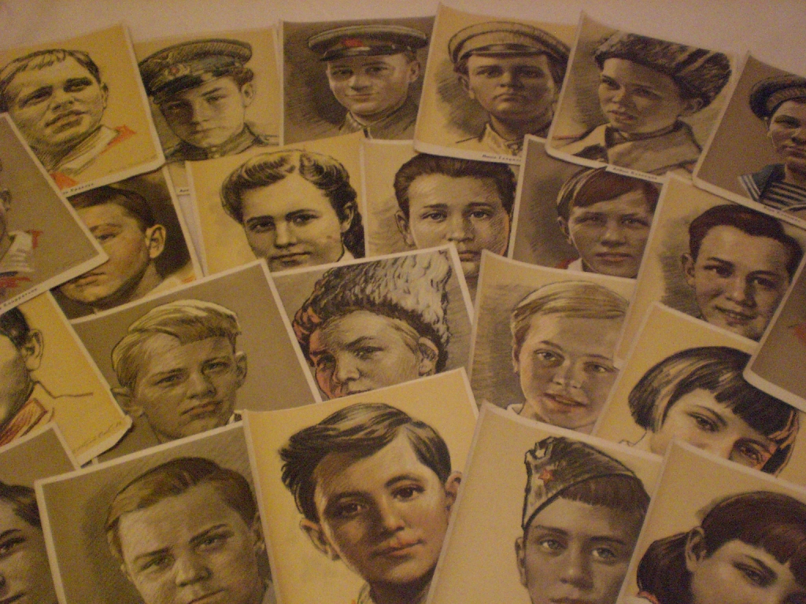
Запомните их имена:
Remember their names
Valya Kotik
Marat Kazey
Galya Komleva
Arkady Kamanin
Zina Portnova
Vasya Korobko
Lara Mikheyenko
Vitya Khomenko
Lida Vashkevich
Sasha Borodulin
Yuta Bondarovskaya
Lenya Golikov
and many many others…
ФОТО а под фото фамилии
Валя Котик
Марат Казей
Зина Портнова
Витя Коробков
Толя Шумов
Володя Дубинин
Леня Голиков
Галя Комлева
Аркадий Каманин
Вася Коробко
Саша Бородулин
и многие-многие другие…

